Slide 1
Autoencoders and Applications
Radu Ionescu, Prof. PhD.
raducu.ionescu@gmail.com
Faculty of Mathematics and Computer Science
University of Bucharest

Slide 2
Agenda
Unsupervised Learning (Introduction)
Autoencoder (AE)
Convolutional AE
Regularization: Sparse
Denoising AE
Masked AE
Contractive AE
Stacked AE
Application: abnormal event detection

Slide 3
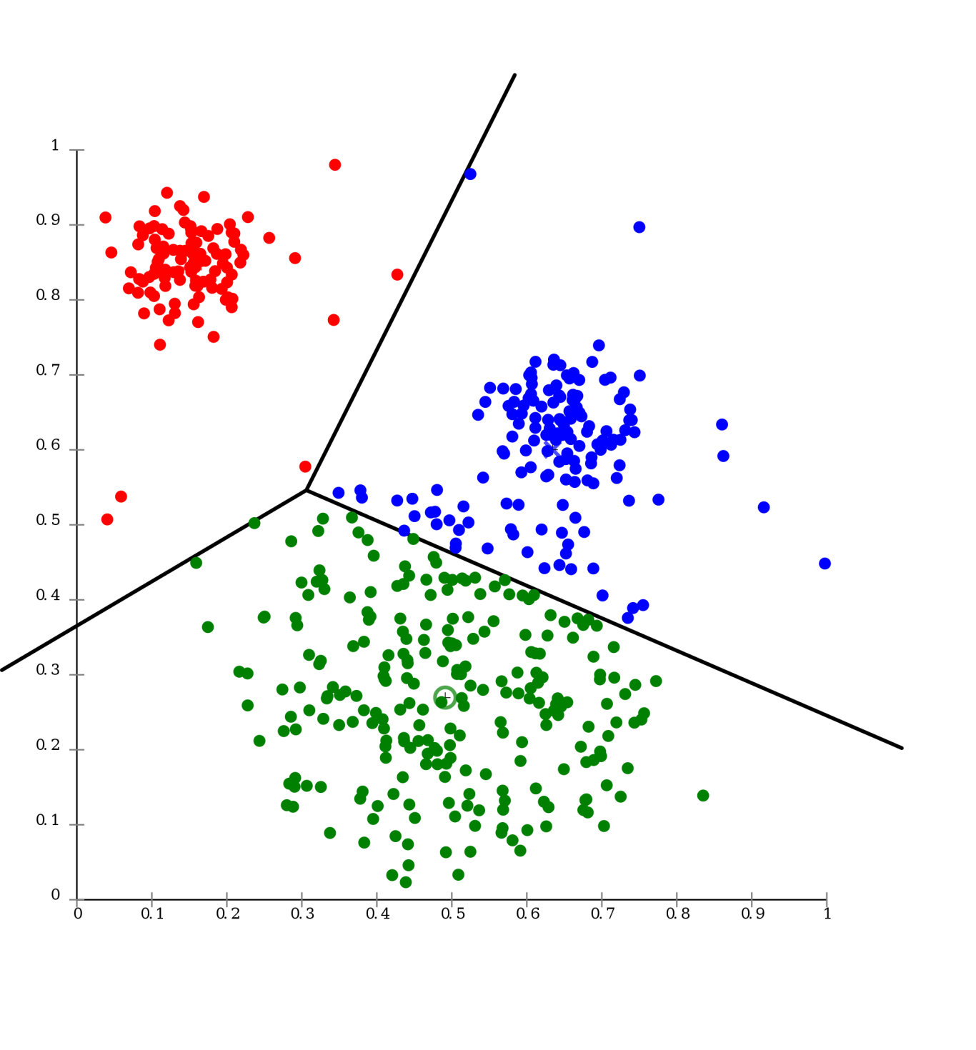
Introduction to Unsupervised Learning

Slide 4

Supervised Learning
Data: (X, Y)
Goal: Learn a Mapping Function f where: f(X) = Y

Slide 5
Supervised Learning
X2
Examples: Classification.
Decision Trees
Naïve Bayes
KNN
SVM
Perceptron
Multi Layer Perceptron
X1
Classification

Slide 6
Supervised Learning
Examples: Regression.
X2
Linear Regression
Ridge Regression
X1
Regression

Slide 7
Supervised Learning vs Unsupervised Learning
What happens when our labels are noisy?
01
Missing values.
Labeled incorrectly.
What happens where we don’t have labels for training at all?
02

Slide 8
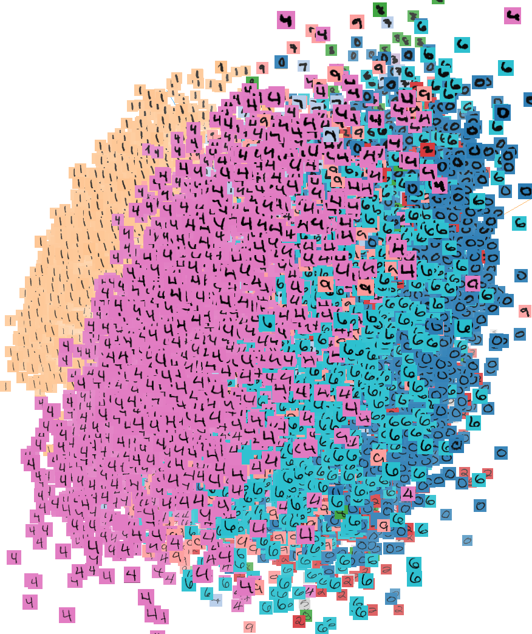
Unsupervised Learning
Data: (X, no labels!)
Goal: Learn the structure of the data
(learn correlations between features)

Slide 9
Unsupervised Learning
Examples:
Clustering
Compression
Feature & Representation learning
Dimensionality reduction
Generative models
etc…

Slide 10
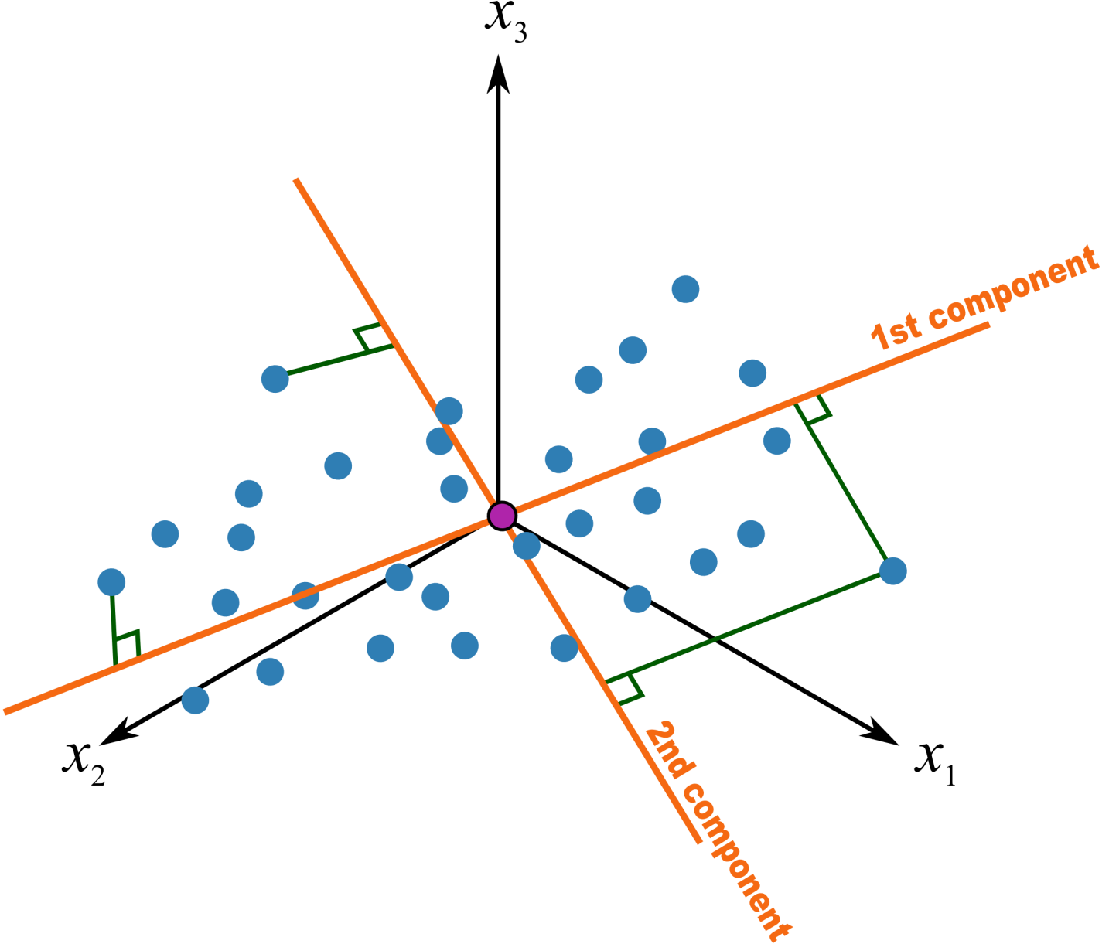
PCA – Principal Component Analysis
Statistical approach for data compression and visualization
Invented by Karl Pearson in 1901
Weakness: linear components only

Slide 11
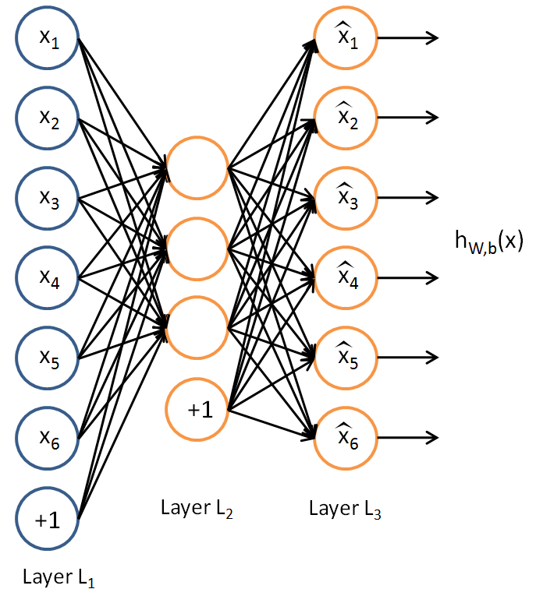
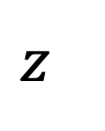
Traditional Autoencoder
Unlike PCA, now we can use activation functions to achieve non-linearity.
It has been shown that an AE without activation functions achieves the PCA capacity.
$$z$$

Slide 12
Applications
The autoencoder idea was a part of NN history for decades (LeCun et al, 1987).
Traditionally, an autoencoder is used for dimensionality reduction and feature learning.
Recently, the connection between autoencoders and latent space modeling has brought autoencoders to the front of generative modeling, as we will see in the next lecture.
Not used for compression.
-Data specific compression.
-Lossy.

Slide 13
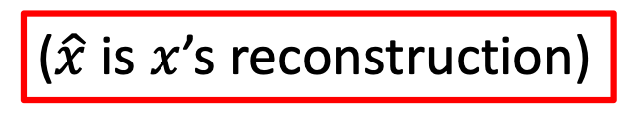
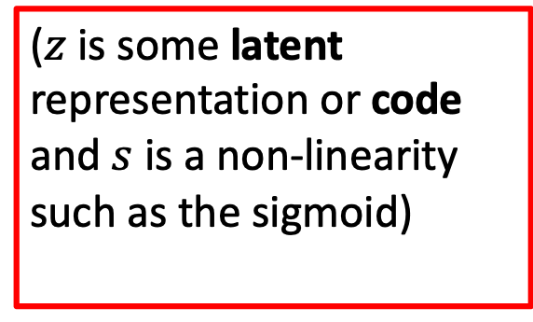
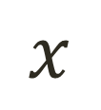
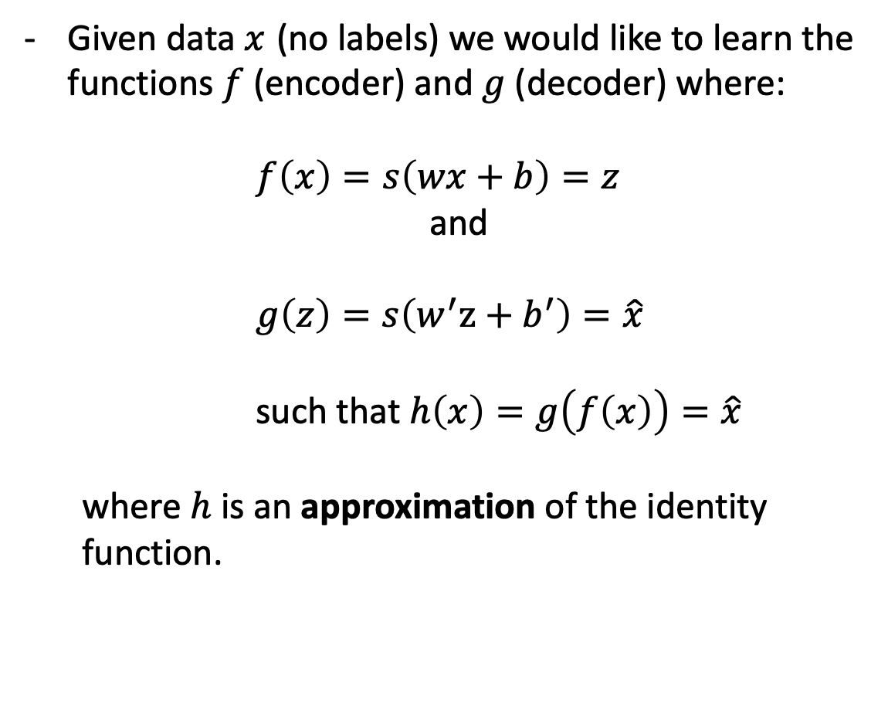
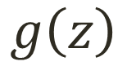
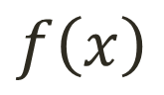

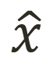
Simple Idea
$$x$$
$$f\left(x\right)$$
$$z$$
$$g\left(z\right)$$
$$\hat{x}$$
Given data $x$ (no labels) we would like to learn the functions $f$ (encoder) and $g$(decoder) where:
$f\left(x\right)=s\left(wx+b\right)=z$
and
$g\left(z\right)=s\left(w^{′}z+b^{′}\right)=\hat{x}$
such that $h\left(x\right)=g\left(f\left(x\right)\right)=\hat{x}$
where $h$ is an approximation of the identity function.
($z$ is some latent representation or code and $s$ is a non-linearity such as the sigmoid)
($\hat{x}$ is $x$’s reconstruction)

Slide 14
Simple Idea
Learning the identity function seems trivial, but with added constraints on the network (such as limiting the number of hidden neurons or regularization) we can learn information about the structure of the data.
Trying to capture the distribution of the data (data specific!)

Slide 15
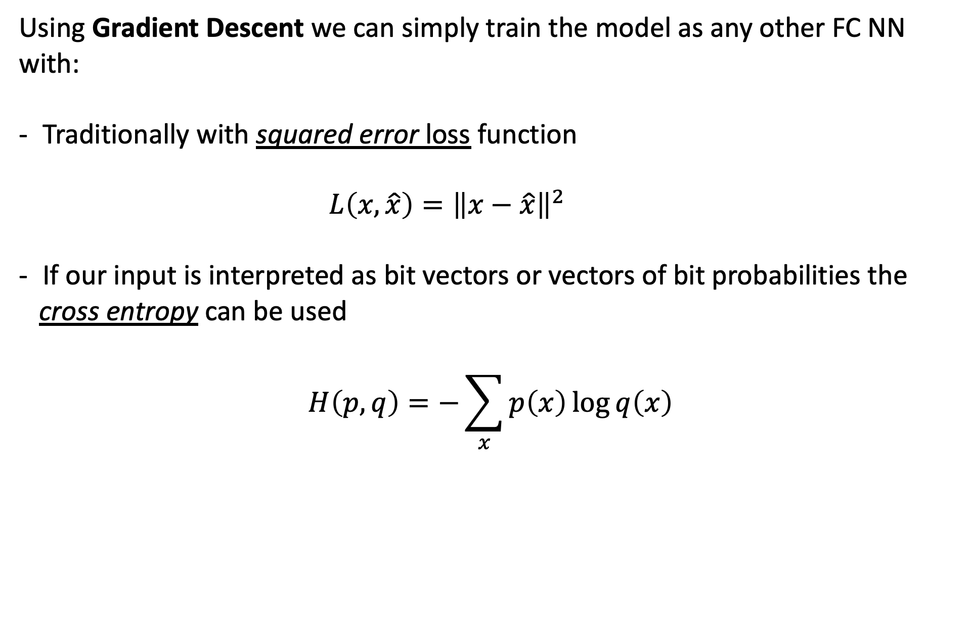
Training the AE
Using Gradient Descent we can simply train the model as any other FC NN with:
Traditionally with squared error loss function
$L\left(x,\hat{x}\right)={\left\|x−\hat{x}\right\|}^{2}$
If our input is interpreted as bit vectors or vectors of bit probabilities the
cross entropy can be used
$$H\left(p,q\right)=−\sum_{x}{p\left(x\right)\log{q\left(x\right)}}$$

Slide 16
Undercomplete AE vs overcomplete AE
We distinguish between two types of AE structures:

Slide 17
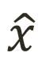
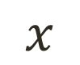
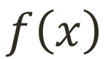


Undercomplete AE
Hidden layer is Undercomplete if smaller than the input layer.
Compresses the input.
Compresses well only for the training distribution.
$$\hat{x}$$
$$w′$$
$$f\left(x\right)$$
Hidden nodes will be:
Good features for the training distribution.
Bad for other types of input.
$$w$$
$$x$$

Slide 18
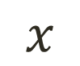
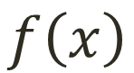
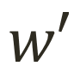

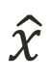
Overcomplete AE
Hidden layer is Overcomplete if greater than the input layer.
No compression in hidden layer.
Each hidden unit could copy a different input component.
$$\hat{x}$$
$$w′$$
No guarantee that the hidden units will extract meaningful structure.
$$f\left(x\right)$$
$$w$$
Adding dimensions is good for training a linear classifier (XOR case example).
A higher-dimensional code helps model a more complex distribution.
$$x$$

Slide 19
Deep Autoencoder Example
https://cs.stanford.edu/people/karpathy/convnetjs/demo/autoencoder.html - By Andrej Karpathy

Slide 20

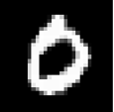

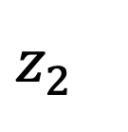
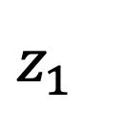
Simple latent space interpolation
$$z_{1}$$
Encoder
$$z_{2}$$
Encoder

Slide 21

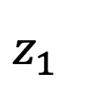
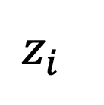
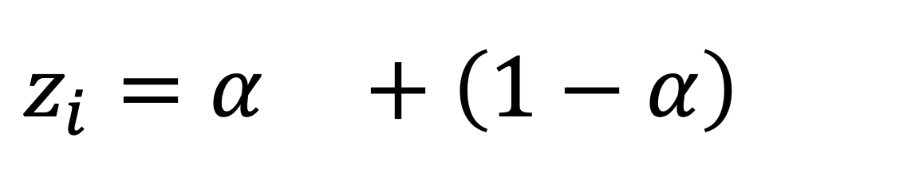
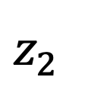
Simple latent space interpolation
$$z_{1}$$
$$z_{2}$$
$$z_{i}=α +\left(1−α\right)$$
$$z_{i}$$
Decoder

Slide 22
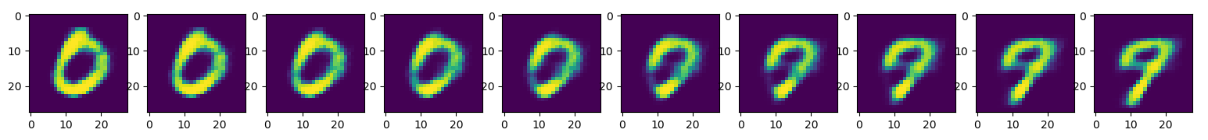
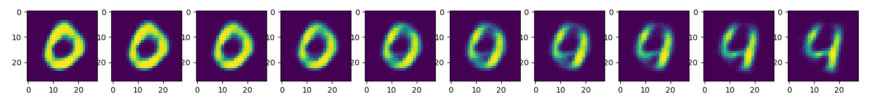
Simple latent space interpolation

Slide 23
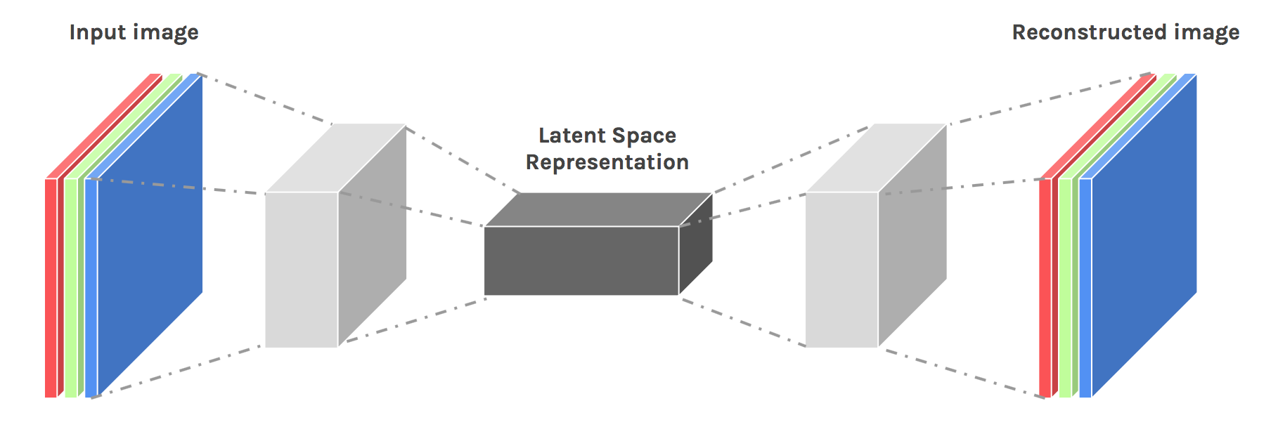
Convolutional AE

Slide 24
Convolutional AE
Input values are normalized
All of the conv layers activation functions are ReLU except for the last conv which is sigmoid
Output
Input
(28,28,1)
C1
(28,28,16)
M.P1
(14,14,16)
C2
(14,14,8)
M.P2
(7,7,8)
C3
(7,7,8)
M.P3
(4,4,8)
D.C1
(4,4,8)
U.S1
(8,8,8)
D.C2
(8,8,8)
U.S2
(16,16,8)
D.C3
(14,14,16)
U.S3
(28,28,8)
D.C4
(28,28,1)
Conv 1
16 F
@ (3,3,1)
same
M.P 1
(2,2)
same
Conv 2
8 F
@ (3,3,16)
same
M.P 2
(2,2)
same
Conv 3
8 F
@ (3,3,8)
same
M.P 3
(2,2)
same
D Conv 1
8 F
@ (3,3,8)
same
U.S 1
(2,2)
D Conv 2
8 F
@ (3,3,8)
same
U.S 2
(2,2)
D Conv 3
16 F
@ (3,3,8)
valid
U.S 3
(2,2)
D Conv 4
1 F
@ (5,5,8)
same
Hidden Code
Encoder
Decoder

Slide 25






Transposed Convolution (Deconvolution)
Stride=1
Pad=Valid
Stride=2
Pad=Valid
Stride=2
Pad=Same
Output
Conv
Input
Output
Deconv
Input
https://github.com/vdumoulin/conv_arithmetic

Slide 26
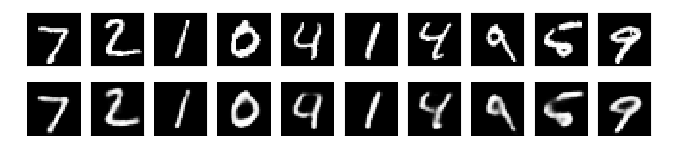
Convolutional AE results
- 50 epochs.
- 88% accuracy on validation set.

Slide 27
Regularization
Motivation:
We would like to learn meaningful features without altering the code’s dimensions (Overcomplete or Undercomplete).
The solution: imposing other constraints on the network.

Slide 28
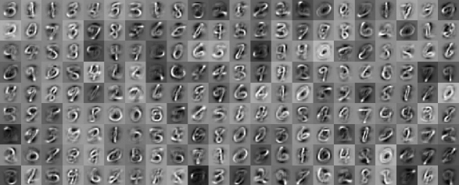
Sparsely Regulated Autoencoders
Activation Maps
A bad example:

Slide 29
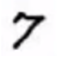
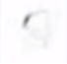

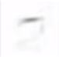
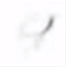
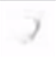

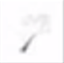

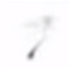
Sparsely Regulated Autoencoders
We want our learned features to be as sparse as possible.
With sparse features we can generalize better.
= 1*
+ 1*
+ 1*
+ 1*
+ 1*
+ 1*
+ 1*
+ 0.8*
+ 0.8*

Slide 30
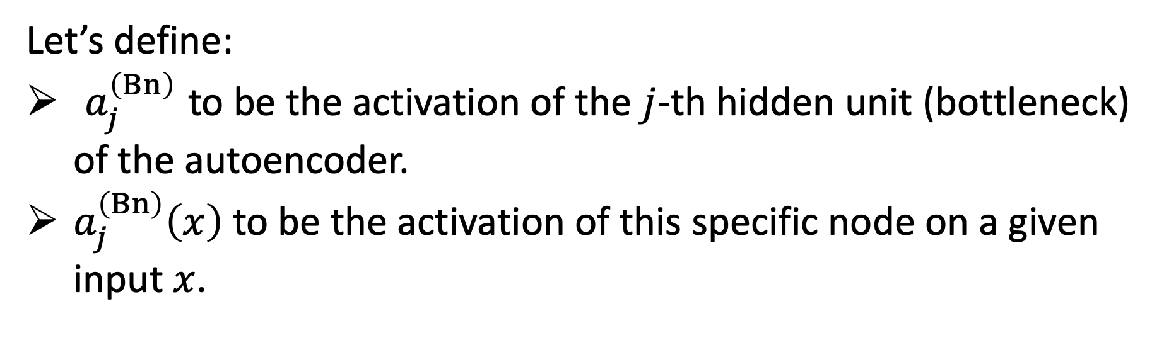
Sparsely Regulated Autoencoders
Let’s define:
$a_{j}^{\left(Bn\right)}$ to be the activation of the $j$-th hidden unit (bottleneck) of the autoencoder.
$a_{j}^{\left(Bn\right)}\left(x\right)$ to be the activation of this specific node on a given input $x$.

Slide 31
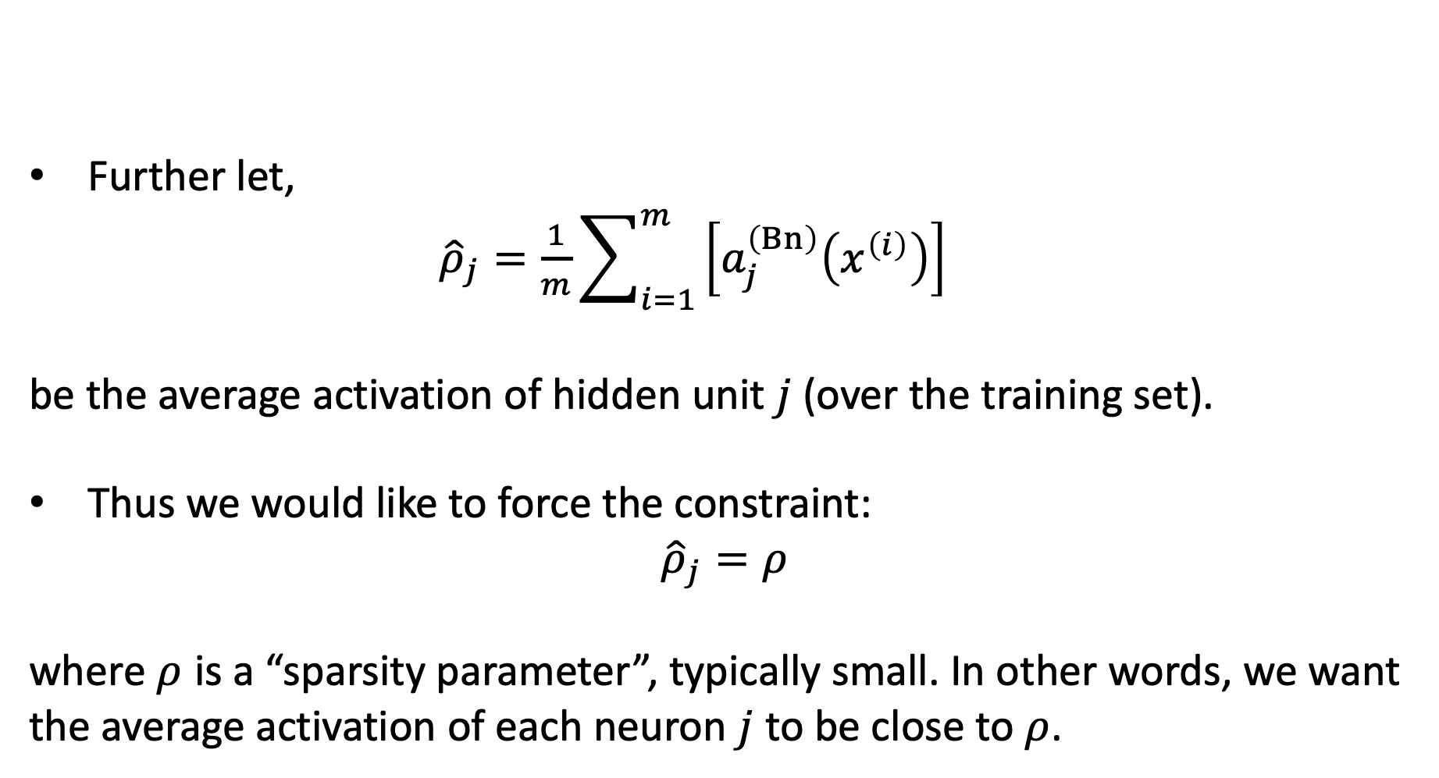
Sparsely Regulated Autoencoders
Further let,
${\hat{ρ}}_{j}=\frac{1}{m}\sum_{i=1}^{m}{\left[a_{j}^{\left(Bn\right)}\left(x^{\left(i\right)}\right)\right]}$
be the average activation of hidden unit $j$ (over the training set).
Thus we would like to force the constraint:
$${\hat{ρ}}_{j}=ρ$$
where $ρ$ is a “sparsity parameter”, typically small. In other words, we want the average activation of each neuron $j$ to be close to $ρ$.

Slide 32
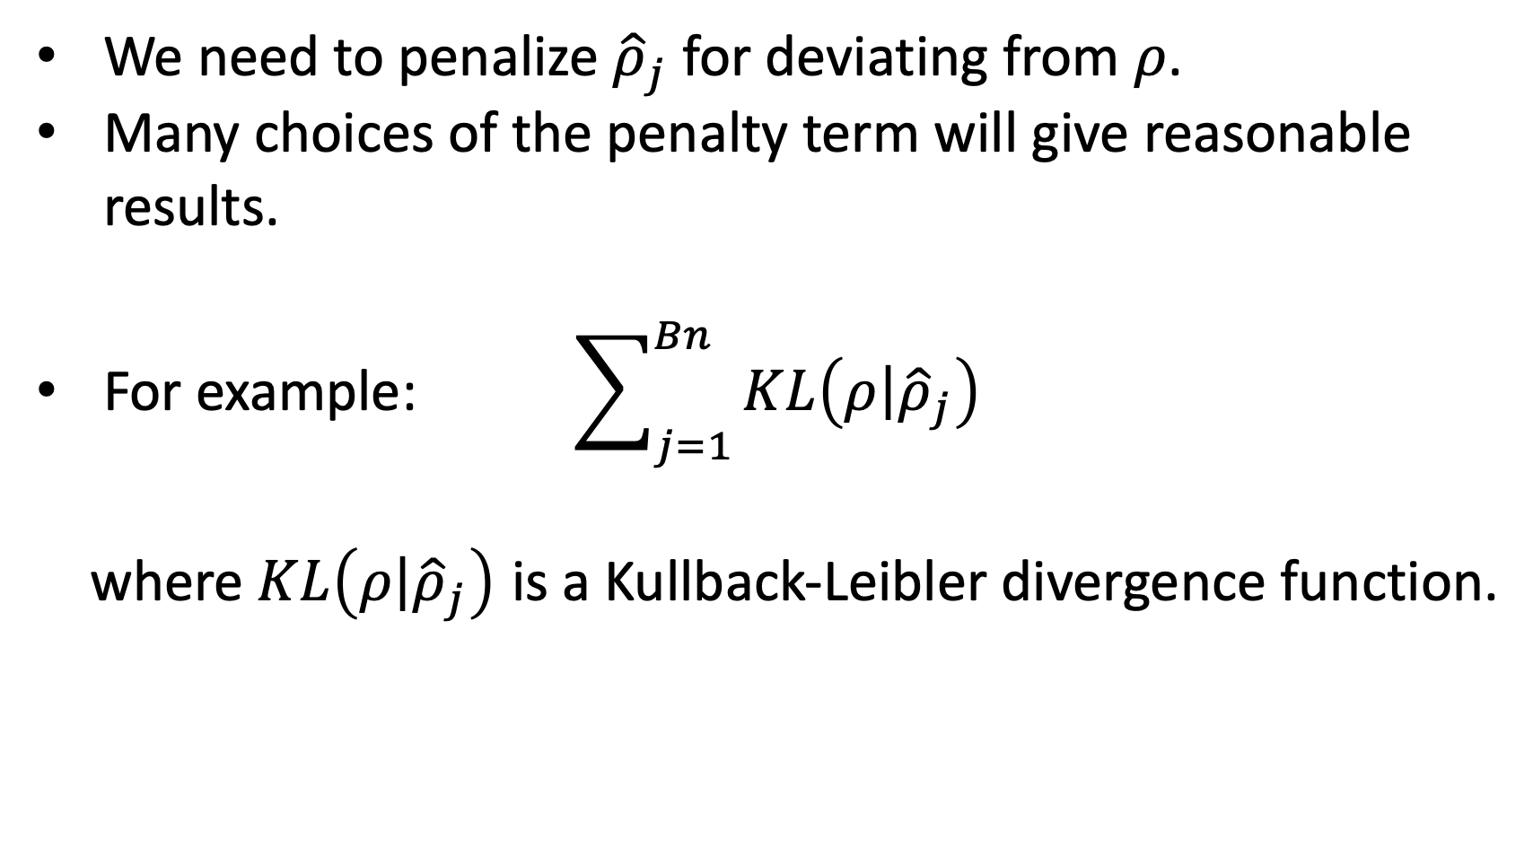
Sparsely Regulated Autoencoders
We need to penalize ${\hat{ρ}}_{j}$ for deviating from $ρ$.
Many choices of the penalty term will give reasonable results.
For example: $\sum_{j=1}^{Bn}{KL\left(\left.ρ\right|{\hat{ρ}}_{j}\right)}$
where $KL\left(\left.ρ\right|{\hat{ρ}}_{j}\right)$ is a Kullback-Leibler divergence function.

Slide 33
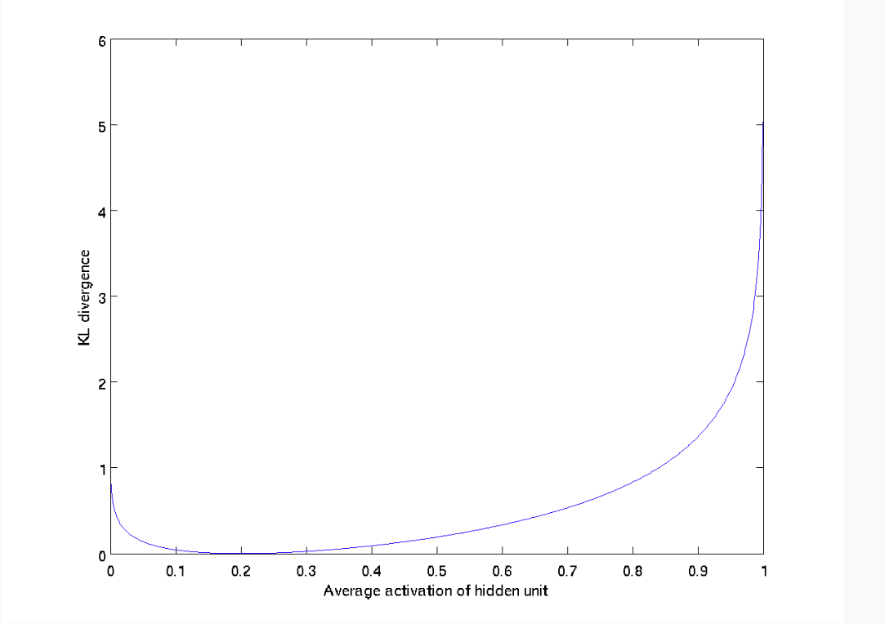
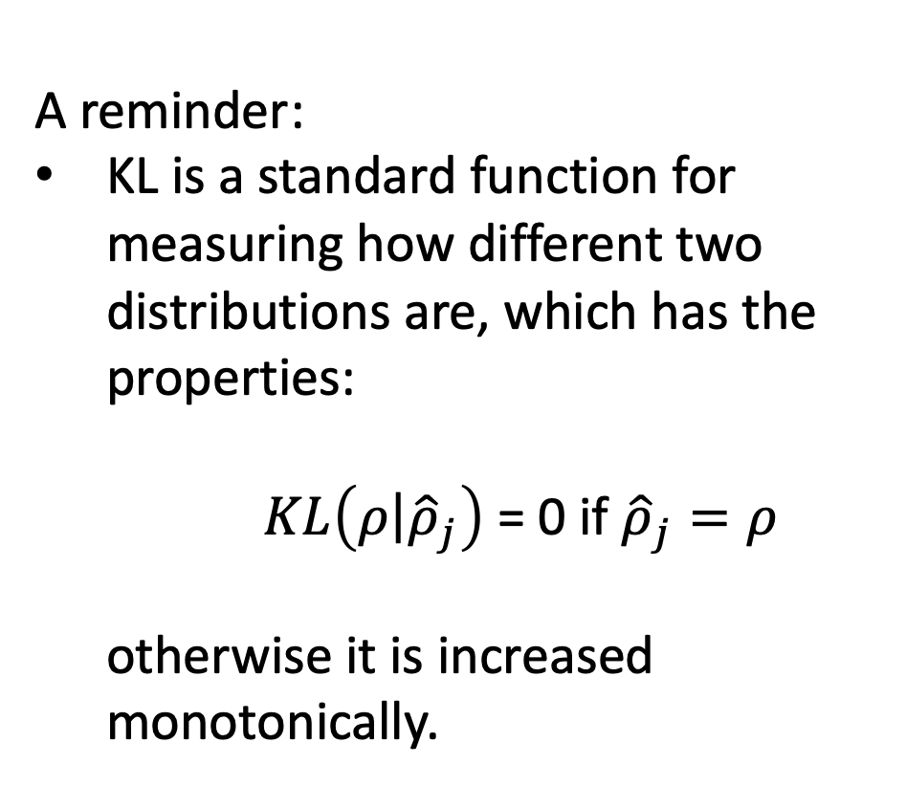
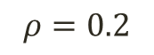
Sparsely Regulated Autoencoders
A reminder:
KL is a standard function for measuring how different two distributions are, which has the properties:
$KL\left(\left.ρ\right|{\hat{ρ}}_{j}\right)$ = 0 if ${\hat{ρ}}_{j}=ρ$
otherwise it is increased monotonically.
$$ρ=0.2$$

Slide 34
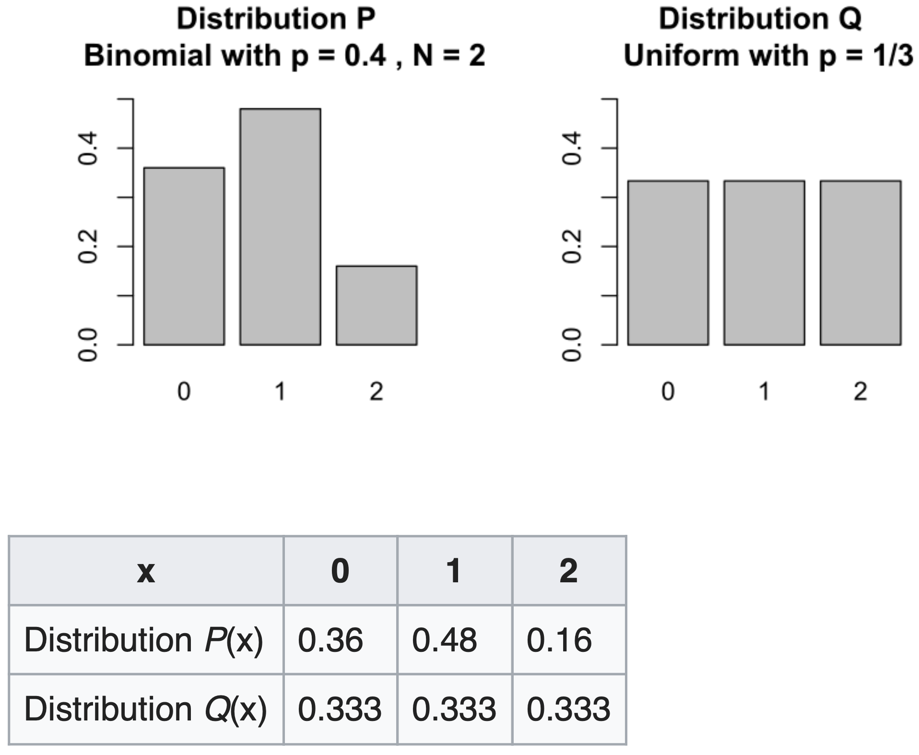
Kullback-Leibler Divergence

Slide 35
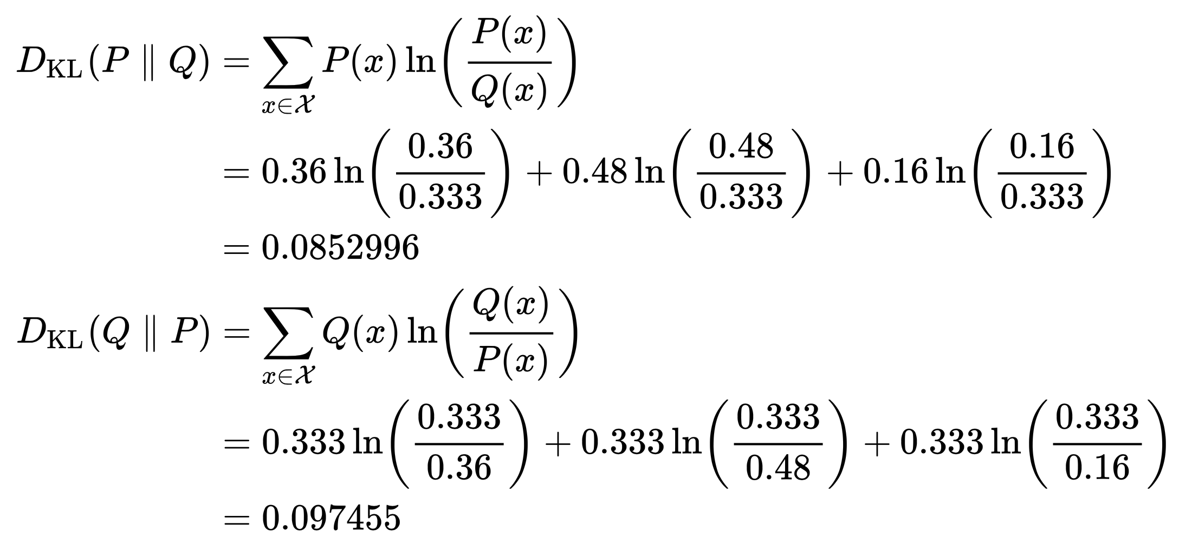
Kullback-Leibler Divergence

Slide 36
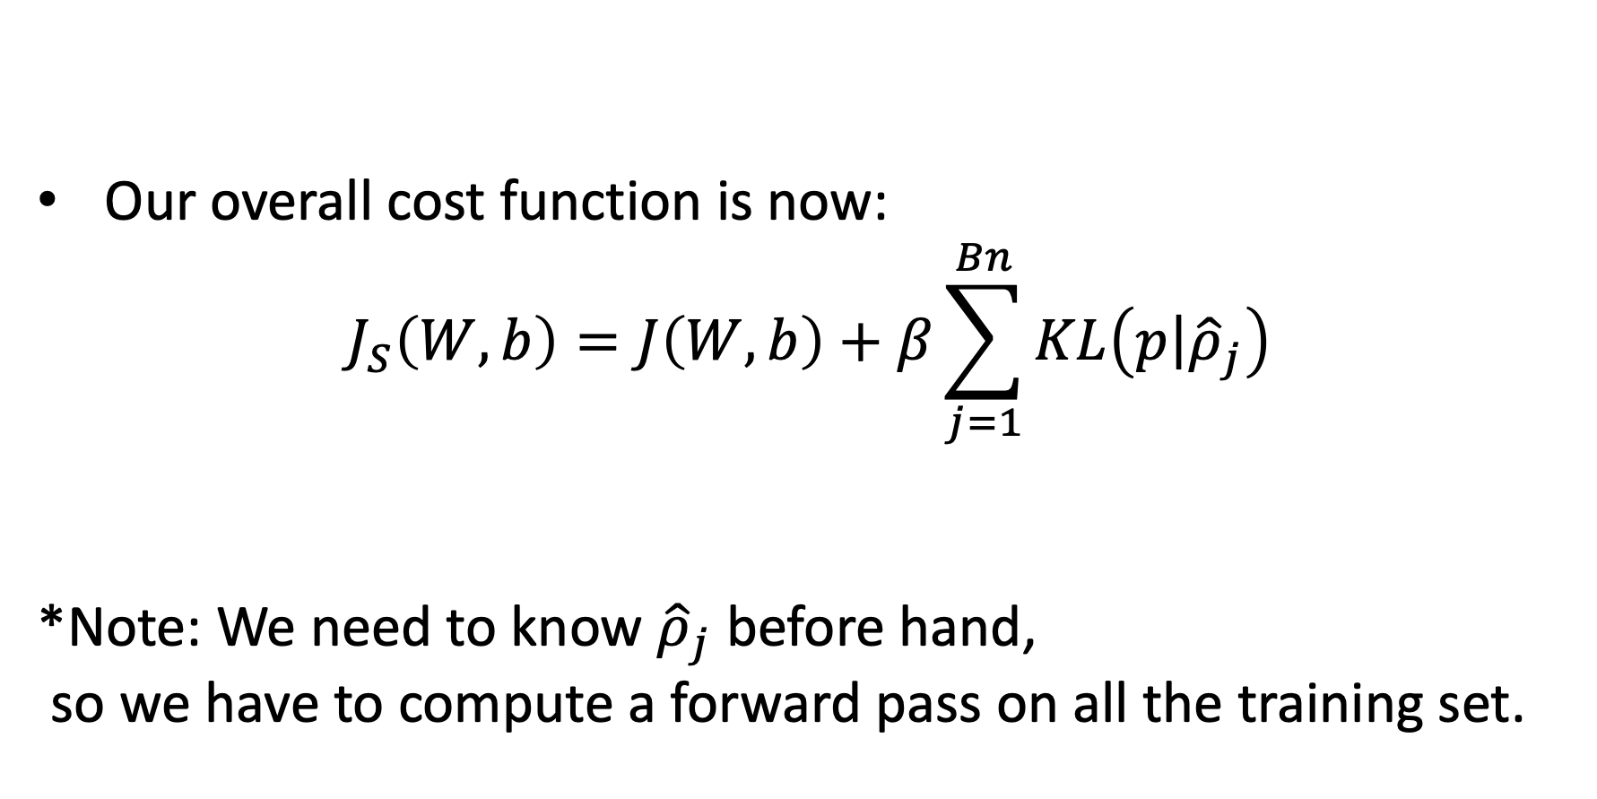
Sparsely Regulated Autoencoders
Our overall cost function is now:
$$J_{S}\left(W,b\right)=J\left(W,b\right)+β\sum_{j=1}^{Bn}{KL\left(\left.p\right|{\hat{ρ}}_{j}\right)}$$
*Note: We need to know ${\hat{ρ}}_{j}$ before hand,
so we have to compute a forward pass on all the training set.

Slide 37
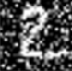

Denoising Autoencoders
Intuition:
We still aim to encode the input and to NOT mimic the identity function.
We try to undo the effect of corruption process stochastically applied to the input.
A more robust model
Encoder
Decoder
Noisy Input
Denoised Input
Latent space representation

Slide 38
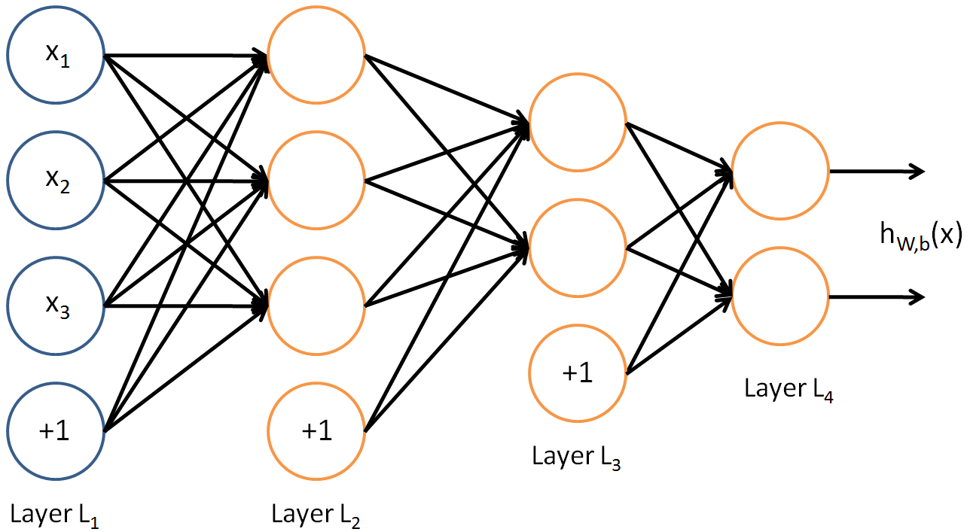
Denoising Autoencoders
Use Case:
Extract robust representation for a NN classifier.
Encoder
Noisy Input
Latent space representation

Slide 39


Denoising Autoencoders
Instead of trying to mimic the identity function by minimizing:
$L\left(x,g\left(f\left(x\right)\right)\right)$
where L is some loss function
A DAE instead minimizes:
$L\left(x,g\left(f\left(\tilde{x}\right)\right)\right)$
where $\tilde{x}$ is a copy of $x$ that has been corrupted by some form of noise.

Slide 40







Denoising Autoencoders
Idea: A robust representation against noise:
Random assignment of subset of inputs to 0, with probability $v$.
Gaussian additive noise.
$$\hat{x}$$
$$w′$$
$$f\left(x\right)$$
$$w$$
$$x$$

Slide 41









Denoising Autoencoders
$$\hat{x}$$
Reconstruction $\hat{x}$ computed from the corrupted input $\tilde{x}$.
Loss function compares $\hat{x}$ reconstruction with the noiseless $x$.
$$w′$$
$$f\left(\tilde{x}\right)$$
The autoencoder cannot fully trust each feature of $x$ independently so it must learn the correlations of $x$’s features.
Based on those relations we can predict a more “not prone to changes” model.
We are forcing the hidden layer to learn a generalized structure of the data.
$$w$$
$$\tilde{x}$$
0
0
0
Noise Process
$$p\left(\left.\tilde{x}\right|x\right)$$
$$x$$

Slide 42




Denoising Autoencoders: process
Taken some input $x$
Apply Noise
$$\tilde{x}$$

Slide 43


Denoising Autoencoders: process
DAE
$$\tilde{x}$$
Encode And Decode
DAE
$$g\left(f\left(\tilde{x}\right)\right)$$

Slide 44



Denoising Autoencoders: process
DAE
DAE
$$g\left(f\left(\tilde{x}\right)\right)$$
$$\hat{x}$$

Slide 45


Denoising Autoencoders: process
Compare
$$x$$
$$\hat{x}$$

Slide 46

Denoising Autoencoders

Slide 47

Denoising Convolutional AE results
- 50 epochs.
- Noise factor 0.5.
- 92% accuracy on validation set.

Slide 48
Masked Autoencoders Are Scalable Vision Learners
K He, X Chen, S Xie, Y Li, P Dollár, R Girshick
CVPR 2022

Slide 49

How MAE Works?
(random masking)

Slide 50
How MAE Works?
(encode visible tokens)

Slide 51
How MAE Works?
(add masked tokens)

Slide 52
How MAE Works?
(reconstruct)

Slide 53
How MAE Works?
The MAE is a type of denoising autoencoder (DAE)
Autoencoding - method for learning representations
Encoder maps input to latent representation
Decoder reconstructs the input
Loss computed w.r.t. mask tokens

Slide 54
Key features of MAE
Masked autoencoder (MAE) uses an asymmetric encoder-decoder design
Pre-training - mask random patches of pixels and reconstruct the image
Fine-tuning / linear probing - evaluate model using image recognition task
Higher masking ratios produced better results

Slide 55
Surpasses supervised pre-training

Slide 56

Reconstructed samples (in-domain = ImageNet)

Slide 57

Reconstructed samples (cross-domain = COCO)

Slide 58
Tested different ways of sampling

Slide 59





Contractive autoencoders
$$\hat{x}$$
We are still trying to avoid uninteresting features.
Here we add a regularization term $Ω\left(x\right)$ to our loss function to limit the hidden layer.
$$w′$$
$$w$$
$$x$$

Slide 60
Contractive autoencoders
$$\hat{x}$$
Idea: We wish to extract features that only reflect variations observed in the training set. We would like to be invariant to the other variations.
Points close to each other in the input space maintain that property in the latent space.
$$w′$$
$$w$$
$$x$$

Slide 61


Contractive autoencoders
Definitions and reminders:
Frobenius norm (L2): ${\left\|A\right\|}_{F}=$
Jacobian Matrix: $J_{f}\left(x\right)$ = $\frac{∂f(x)}{∂x}$ = $\left[\begin{matrix}\frac{∂f{\left(x\right)}_{1}}{∂x_{1}} & ⋯ & \frac{∂f{\left(x\right)}_{1}}{∂x_{n}} \\ ⋮ & ⋱ & ⋮ \\ \frac{∂f{\left(x\right)}_{m}}{∂x_{1}} & ⋯ & \frac{{∂f\left(x\right)}_{m}}{∂x_{n}}\end{matrix}\right]$
$$\sqrt{Σ_{i,j}{\left|a_{ij}\right|}^{2}}$$

Slide 62

Contractive autoencoders
Our new loss function would be:
$$L^{∗}\left(x\right)=L\left(x\right)+λΩ\left(x\right)$$
where $Ω\left(x\right)={\left\|J_{f}\left(x\right)\right\|}_{F}^{2}$ or simply: $\sum_{i,j}{{\left(\frac{∂f{\left(x\right)}_{j}}{∂x_{i}}\right)}^{2}}$
and where $λ$ controls the balance of our reconstruction objective and the hidden layer “flatness”.

Slide 63

Contractive autoencoders
Our new loss function would be:
$$L^{∗}\left(x\right)=L\left(x\right)+λΩ\left(x\right)$$
$L\left(x\right)$ - would be an encoder that keeps as much information as possible ($λ→0$)
$Ω\left(x\right)$ - would be an encoder that throws away all information ($λ→∞$)
Combination would be an encoder that keeps only good information.

Slide 64



Contractive autoencoders
Encoder doesn’t need to be sensitive to this variation (not observed in training data)
Encoder must be sensitive to this variation to reconstruct well

Slide 65
Which autoencoder?
DAE make the reconstruction function resist small, finite sized perturbations in input.
CAE make the feature encoding function resist small, infinitesimal perturbations in input.
Both denoising AE and contractive AE perform well!

Slide 66
Which autoencoder?
Advantage of DAE: simpler to implement
Requires adding one or two lines of code to regular AE.
No need to compute Jacobian of hidden layer.
Advantage of CAE: gradient is deterministic
Might be more stable than DAE, which uses a sampled gradient.
One less hyper-parameter to tune (noise-factor)

Slide 67
Stacked AE
Motivation:
We want to harness the feature extraction quality of a AE for our advantage.
For example: we can build a deep supervised classifier where its input is the output of a SAE.
The benefit: our deep model’s W are not randomly initialized but are rather “smartly selected”
Also using this unsupervised technique lets us have a larger unlabeled dataset.

Slide 68
Stacked AE
Building a SAE consists of two phases:
1. Train each AE layer one after the other.
2. Connect any classifier (SVM / FC NN layer etc.)

Slide 69


Stacked AE
SAE
Classifier
$$x$$
$$y$$

Slide 70



Stacked AE: process
First Layer Training (AE 1)
$$x$$
$$f_{1}\left(x\right)$$
$$z_{1}$$
$$g_{1}\left(z_{1}\right)$$
$$\hat{x}$$

Slide 71





Stacked AE: process
Second Layer Training (AE 2)
$$x$$
$$f_{1}\left(x\right)$$
$$z_{1}$$
$$f_{2}\left(z_{1}\right)$$
$$z_{2}$$
$$g_{2}\left(z_{2}\right)$$
$${\hat{z}}_{1}$$

Slide 72

Stacked AE: process
Add any classifier
Classifier
$$x$$
$$f_{1}\left(x\right)$$
$$z_{1}$$
$$f_{2}\left(z_{1}\right)$$
$$z_{2}$$
Output

Slide 73

Autoencoders: applications
Image colorization: input black and white and train to produce color images

Slide 74

Autoencoders: applications
Watermark removal

Slide 75
Object-centric Auto-encoders and Dummy Anomalies for Abnormal Event Detection in Video
RT Ionescu, FS Khan, MI Georgescu, L Shao
CVPR 2019

Slide 76


Abnormal event detection
Abnormal event detection in video is a challenging task
What an abnormal event looks like depends on the context!
Examples:
car driving by on the street versus car driving in a pedestrian area
person jogging versus person running outside a bank
Notes:
Notes:
The task is ill-defined

Slide 77
Problem definition
Hard to find a sufficiently representative set of anomalies
=> Traditional supervised learning methods are ruled out
Hypothesis: Abnormal events should be unexpected events that occur less often than familiar (normal) events
=> Normal events can be easily collected for training
=> Usually formalized as outlier detection
Notes:
Notes:
One
Two

Slide 78
Common approaches
Usual abnormal event detection approaches learn a model of familiarity from training videos and label events as abnormal if they deviate from the model
A few approaches (unsupervised) do not require any training data
Notes:
Notes:
One
Two

Slide 79

Notes:
This figure illustrates our pipeline
During training, we apply a two-stage outlier detection algorithm based on k-means and one-class SVM
We eliminate the smaller k-means clusters as outliers, and, for each remaining cluster, we shrink the borders using one-class SVM
During inference, we label a test sample as abnormal if its maximum normality score among the scores provided by the trained one-class SVM models is negative

Slide 80


Slide 81
Data Sets
Avenue [Lu et al, ICCV13]
Subway [Adam et al, PAMI08]
ShanghaiTech [Luo et al., ICCV 2017]
UMN [Mehran et al, CVPR09]
Area under the ROC curve (AUC) computed with respect to:
ground-truth frame-level annotations
Evaluation Metrics
Notes:
We compare our approach with several state-of-the-art methods on three data sets: Avenue, Subway and UMN
As evaluation metrics, we employ the Area under the ROC curve (AUC) computed with respect to ground-truth frame-level annotations and, when available, ground-truth pixel-level annotations

Slide 82

Preliminary results on ShanghaiTech
Notes:
We compare our approach with several state-of-the-art methods on three data sets: Avenue, Subway and UMN
As evaluation metrics, we employ the Area under the ROC curve (AUC) computed with respect to ground-truth frame-level annotations and, when available, ground-truth pixel-level annotations

Slide 83

Notes:
We compare our approach with several state-of-the-art methods on three data sets: Avenue, Subway and UMN
As evaluation metrics, we employ the Area under the ROC curve (AUC) computed with respect to ground-truth frame-level annotations and, when available, ground-truth pixel-level annotations

Slide 84


Slide 85

Video example for anomaly localization

Slide 86
Remarks
Better results by training deep auto-encoder features than using pre-trained CNN features
Focusing on objects helps to improve accuracy over state-of-the-art
Including one-versus-rest supervision is very useful

Slide 87
A Background-Agnostic Framework with Adversarial Training for Abnormal Event Detection in Video
MI Georgescu, RT Ionescu,
FS Khan, M Popescu, M Shah
TPAMI 2022
(extension of CVPR 2019)

Slide 88
Motivation
Hard to collect normal / abnormal examples
Need pseudo-abnormal / adversarial samples in order to train a better anomaly detection algorithm
The same anomaly model should work on multiple scenes with different backgrounds

Slide 89
Our contributions
A novel framework that leverages adversarial training in the context of abnormal event detection in video
Our framework is background agnostic by performing a series of cross-database experiments

Slide 90


Slide 91


Slide 92

Results on Avenue

Slide 93

Results on ShanghaiTech

Slide 94

Results on ShanghaiTech
Notes:
And these are the results on Subway
We notice that our method surpasses the other methods by a large margin

Slide 95

Cross-database results

Slide 96

Video example of anomaly localization
Notes:
And these are the results on Subway
We notice that our method surpasses the other methods by a large margin

Slide 97

Video example of anomaly localization
Notes:
And these are the results on Subway
We notice that our method surpasses the other methods by a large margin

Slide 98

Video example of anomaly localization
Notes:
And these are the results on Subway
We notice that our method surpasses the other methods by a large margin

Slide 99

Video example of anomaly localization
Notes:
And these are the results on Subway
We notice that our method surpasses the other methods by a large margin

Slide 100

Video example of anomaly localization
Notes:
And these are the results on Subway
We notice that our method surpasses the other methods by a large margin

Slide 101
Conclusions
We modified the convolutional auto-encoders by adding adversarial and segmentation branches
Our design changes resulted in significant performance improvements in terms of both RBDC and TBDC
Our experiments conducted on Avenue, ShanghaiTech, Subway and UCSD Ped2 indicate that our approach generally attains state-of-the-art results
We also demonstrated that our approach is background-agnostic

